Slide 1

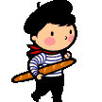
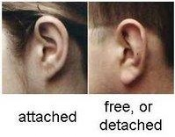
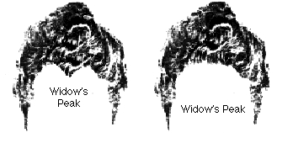
The world is filled with approximately
6,700,000,000 people.
All of us are different in many ways.
For example, we exhibit different traits:
Widow’s Peak
No
Widow’s Peak
Attached
ear lobe
Free
ear lobe
Notes:
Bottom left figure: Retrieved April, 23rd, 2010 from: library.thinkquest.org/C0118084/...ples.htm
Bottom right: Retrieved April, 23rd, 2010 from: www.woodrow.org/teachers/bi/1997...air.html

Slide 2

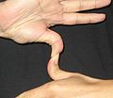

What are some of the differences in traits between you and your classmates?
Hitch-hiker’s thumb?
Dimple?
Ability to roll tongue?
Notes:
1st figure from the left: Retrieved May, 14th, 2010 from: http://en.wikipedia.org/wiki/File:Hitchhiker's_thumbs.jpg
2nd and 3rd figure from the left: No copyrights
Bottom right: Retrieved April, 23rd, 2010 from: www.woodrow.org/teachers/bi/1997...air.html

Slide 3
How do these traits come about ?
It has been found that inherited materials passed on from parents to offspring are responsible for the traits observed in the offspring.
This explains why some traits may be common between parents and their offspring.
Let us examine whether this is true using pea plants as example …

Slide 4
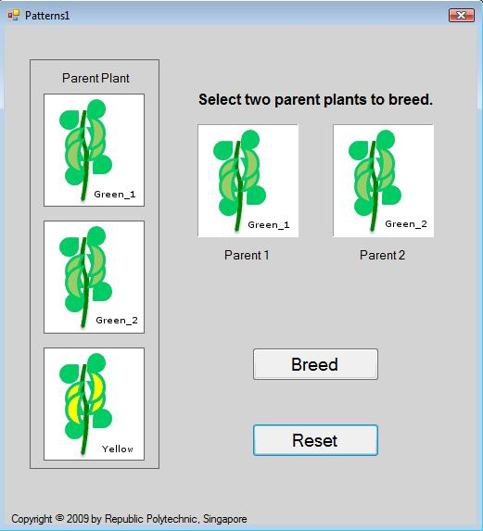
Class Activity
Explore Patterns1.exe and state your observations.

Slide 5
Your challenge for the day!
    Using the programs provided, explain the observations and trends in the traits of the parents and offspring.
    Extend what you have learnt to other cases where traits are being passed on.
Notes:
1st statement: Can expand by asking multiple generations.

